Slide 1
Inheritance

Slide 2
Python Inheritance
Inheritance : It allows us to define a class that inherits all the methods and
properties from another class.
Parent class /Base Class : Which methods and properties being inherited
Child Class / Derived Class : Which inherits properites and method of other
class
Any class can be a Parent Class
While defining a child class , we just need to pass the name of parent class
as an argument
# __init__() Function and child class : If we define __init__() function in child
class then it will overide the functionality of inherited __init__() function of parent
class .
# __init__() this function call automatically on object creation of child class.
# Note : we can explicity call parent class __init__() function inside the definition
of child class __init__() funciton as follow :
ParentClassName.__init__()

Slide 3
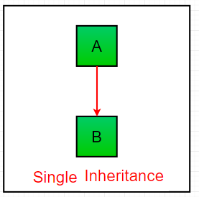
Types of Inheritance in Python: Single Inheritance

Slide 4
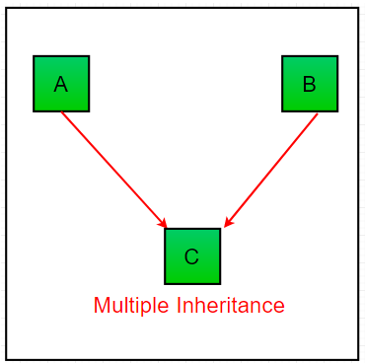
Multiple Inheritance

Slide 5
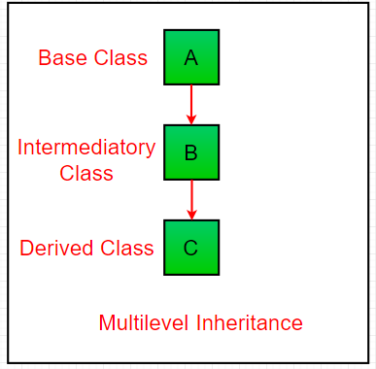
Multilevel Inheritance

Slide 6
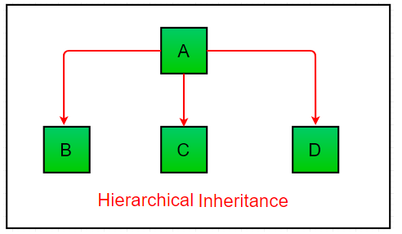
Hierarchical Inheritance

Slide 7
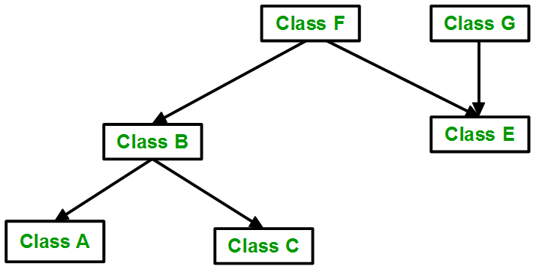
Hybrid Inheritance

Slide 8
Use the super() Function in Child Class
# super() function is used to access any property and method of parent class
# We can add new properties and method in child class as its own

